Slide 1


Florida International University
PokerBots 2025
Lesson 2: Probability Fundamentals

Slide 2



Thank you sponsors
GTO Wizard & Octopi Poker

Slide 3

Today’s Agenda
Pot Odds and Outs
Implied Odds
Board Texture Considerations
Ranges
Kolmogorov Axioms
Random Variables and Distributions
Variance
Law of Large Numbers
Monte Carlo Simulation

Slide 4

Defining Equity (P)
At any point in the game there exists some fixed probability of winning, we call this Equity (P)
In reality P is often hard to explicitly calculate, but we can reasonably estimate

Slide 5

Expected Value
The notion of expected value (EV) is used to summarize distributions on real numbers by some representative value
In short, “expected value” is just another way to say “mean”
Finite events with equal probability → take the average
EV of dice roll: (1+2+3+4+5+6)/6 = 3.5

Slide 6
Expected Value (cont.)
What about events with different probabilities?
Generalize to weighted average (weighted by probability)
X is a random variable with possible values in set S
E[X] = Σ s∈S s * P(X = s)
For continuous distributions, this generalizes to an integral calculation

Slide 7

Expected Value in Poker
How many chips we expect to win/lose on average
EV of folding = 0 * pot_total - 0 * continue_cost = 0
EV of calling a bet = (P * pot_total) − ((1 − P) * continue_cost)
If Equity (P) ≥ (continue_cost / (pot_total + continue_cost)), it is reasonable to call/bet.
We call “continue_cost / (pot_total + continue_cost)” our Pot Odds.

Slide 8
Estimating Equity by Counting Outs
An Out is a card that would complete our hand or make us significantly stronger
Idea: If we count our outs, we can estimate the probability of finding cards we need
We can use this to estimate our probability of winning P
Strategy:
Count the number of cards that complete our hand (outs)
Multiply this number by 2 (1/52 cards gives ~2% chance of getting a specific card)
If we have two cards left to see (turn and river), multiply by 2.
This number is our probability estimate! (as a percent)

Slide 9

Counting Outs Exercise
How can we hit a straight?
Any Ace or Nine (8 outs)
Only 1 card left to come, so 1 * 8 * 2% = 16%
How can we hit second pair?
Any Jack or Queen (6 outs)
Only 1 card left to come, so 1 * 6 * 2% = 12%
P, assuming opponent does not have top pair or better: 28%
P > 0.1, so we call!

Slide 10
Pot Odds and Outs
Pot odds are the ratio between the current size of the pot and the cost of your next call, representing the price you should be willing to pay relative to what you could win.
Calculated as: (cost_to_call) / (cost_to_call + current_pot_size)
To make a mathematically profitable decision, your equity (probability of winning) must exceed your pot odds - if you need to call $50 into a $150 pot (25% pot odds), you need a better than 25% chance of winning.

Slide 11

Pot Odds and Outs (Exercise)
You have K9s of Hearts in you hand
The Flop comes: 2♥7♥Q♣
Giving you a flush draw (need one more heart to complete your flush)
The pot currently contains $100
Your opponent bets $50
You must decide to call or fold

Slide 12
Pot Odds and Outs (Calculation)
Calculate the odds you’re facing:
Continue cost $50
Total pot after opponent’s bet: $150
Pot odds = $50 / ($50 + $150) = $50/$200 = ¼ (25%)
Calculate your Equity (Probability of Winning):
You have 9 outs to complete your flush (13 hearts total - you see 4)
With one card to come (just ‘turn’ card), your probability is approx. 9/47 = ~19%
With two cards to come (turn and river), your probability is approximately 35%

Slide 13

Pot Odds and Outs (Decision Making)
If playing just to the turn card (one card), is 19% equity enough to call against 25% pot odds?
If seeing both turn and river (two cards), is 35% equity enough to call against 25% pot odds?
What is your EV in each situation?
Decision Making Analysis
Equity: 19%, Pot Odds: 25% -> Not enough Equity
EV = (0.19 x $150) - (0.81 x $50)
EV = $28.50 - $40.50 = -$12.00
A negative EV of $12 tells us this call is long-term unprofitable.

Slide 14
Pot Odds and Outs
How would your decision change if the opponent had bet $25 instead? 75$?
What might influence your decision in this situation beyond math?

Slide 15
Pot Odds and Outs
Reverse Pot Odds
If we overbet relative to the size of the pot, then we give our opponent the opportunity to exploit pot odds.
If they have a bad hand, we win a little
If they have “the nuts,” we lose a lot
This is called “Value-Owning” yourself

Slide 16
Pot Odds and Outs
Example: All-in Bot
Scenario: Opponent goes all-in before the flop every hand
What P do we need to call profitably as the big blind?
pot_total = 402
continue_cost = 398
pot odds = 398 / (402 + 398) = 0.4975
If P ≥ 0.4975, we should call!
Fun fact: Q5o tends to beat 50% of starting hands

Slide 17
Implied Odds
The amount of money you expect to win on later streets if you hit one of your Outs
Enables us to call when we don't have the right pot odds
Important to consider when we have a drawing hand
Updated Equity
Pot odds cutoff: we should stay in the game if: P ≥ continue_cost / (pot_total + continue_cost)
Implied odds cutoff: we should stay in the game if: P ≥ continue_cost / (pot_total + continue_cost + future_win_amount)

Slide 18
Implied Odds (ex.)
You have J♦T♦ on a board of 4♦9♦2♣
The flop is checked through by both players
Turn card: 7♣
Current board: 4♦9♦2♣7♣
You're on a flush draw (9 outs)
Current pot size: $150
Opponent bets: $50
Your call cost: $50
Probability of hitting your flush on the turn: 9/46 ≈ 19.6%
But here's the key difference: If you hit your flush, you expect your opponent to call a $100 bet on the river (they have a strong hand and won’t fold).

Slide 19
Implied Odds (ex.)
You have J♦T♦ on a board of 4♦9♦2♣
You're on a flush draw (9 outs)
Current pot size: $150
Opponent bets: $50
Your call cost: $50
Pot odds: $50 / $250 = ⅕ = 20%
Probability of hitting your flush on the turn: 9/46 ≈ 19.6%
Additional money you expect to win if you hit: $100
"Effective pot": $150 + $50 + $100 = $300
Implied pot odds: $50/$300 = 1/6 = 16.7%
Analysis: While the direct pot odds are $50/$250 = 20%, the implied odds reduce to 16.7% because of the additional $100 you expect to win. Since your 19.6% probability of hitting exceeds this 16.7% threshold, the call becomes even more profitable when considering implied odds.

Slide 20



Board Texture Considerations
How connected the board is
Dry → hands are not likely to improve as more cards come
Wet → hands are likely to improve as more cards come
Dry Board Standard Board Wet Board
Flop Bet Sizes?

Slide 21
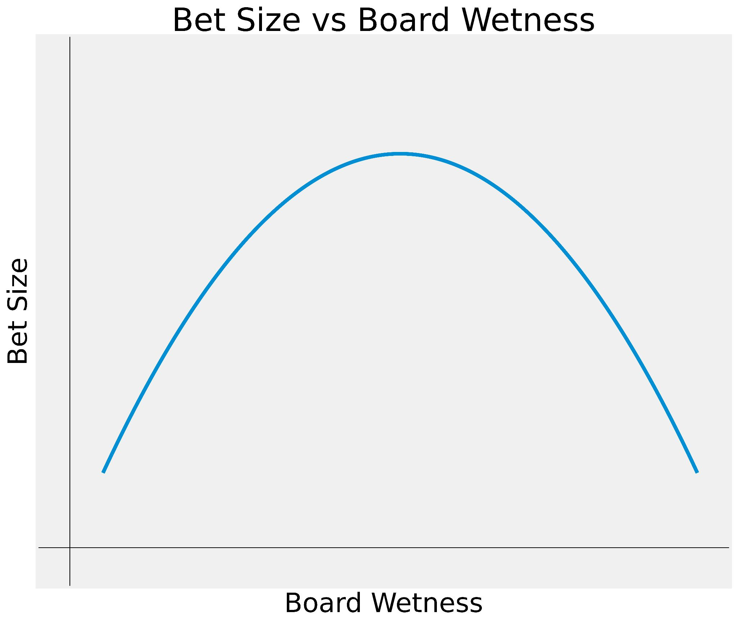
Board Texture Considerations
Board Texture Exercise
Two flush draws
Several straight draws: 9T, TJ, AJ
Board is wet, we don’t want opponents to complete their draws cheaply
Go all-in!

Slide 22
Ranges
We know the pot odds when faced with any bet:
If we can estimate Equity (P) better than our opponent, then we will make money on average
What affects Equity (P)?
Factors of win probability
Bluffing
Betting style
Board and Hole cards
Ranges

Slide 23
Ranges
Ranges in poker refer to the possible hands a player may be holding given the current Game State.
What makes a good range?
Tight-aggressive
Balanced ranges -> includes playing a mix of strong hands and weaker hands (as bluffs or draws)
Adaptability -> ranges are dynamic and should be adjusted based on opponent

Slide 24
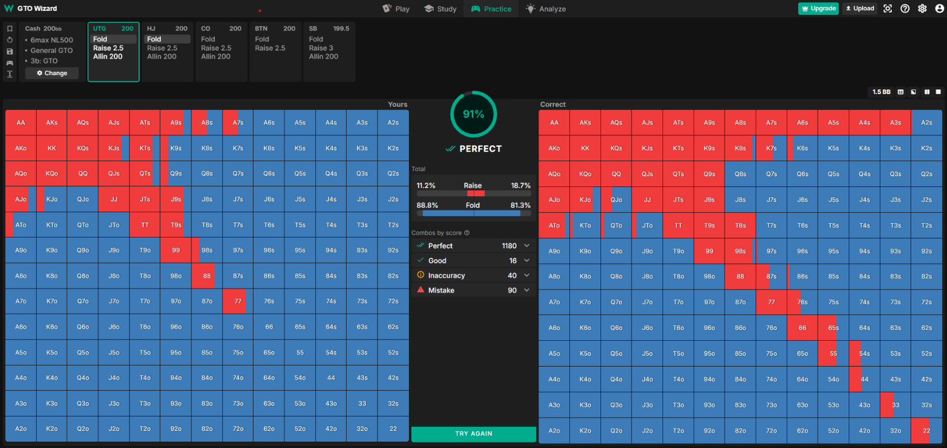
My UTG Range Vs. GTO UTG Range

Slide 25
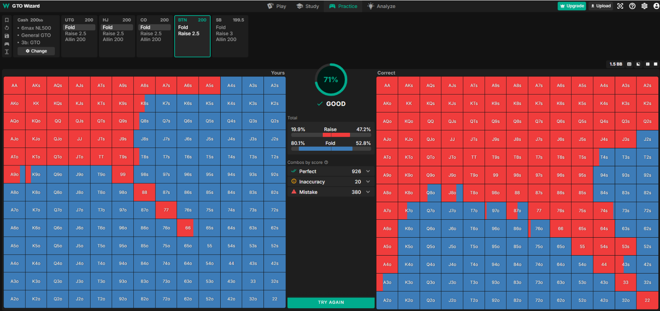
My BTN Range Vs. GTO BTN Range

Slide 26

Probability Foundations
We say “probability of [event] happening is x”
x is usually a number from 0 to 1 or a percent
But what does x’s value mean?

Slide 27
Interpretations of Probability
Frequentist
How often an event occurs over repeated trials
Ex: When rolling a dice repeatedly, we notice 1/6th of rolls are a 2
What about events that aren’t repeated? Eg: 2024 election

Slide 28
Interpretations of Probability
Subjectivist (Bayesian)
Degree of belief, or ‘credence’ of an event occurring from the perspective of an individual with a given set of information
Different pieces of information ‘update’ the probability to be higher or lower depending on how much evidence they provide for the event
However, this requires some assumptions for which default probability values to start with before any updates

Slide 29
Motivation: Finite Possibilities with Equal Chance
Wish to find/define probability of some event that occurs in some outcomes
An intuitive definition: Probability of event = (# favorable outcomes) / (# total outcomes)
Ex: Randomly draw card from standard deck, probability of Spades
13 cards with spades
52 cards total
13/52 → ¼

Slide 30
Motivation: Finite Possibilities with Equal Chance (cont.)
This reduces any question of probability into a counting problem
What about outcomes with unequal chance?
Or infinite outcomes? (e.g. continuous spectrum of possibilities)
We need some general way to define their events and probabilities

Slide 31
2.6 Kolmogorov Axioms
Events are viewed as sets of outcomes, and every set is a subset of the largest set Ω, which can be viewed as the ‘universal’ set encompassing all outcomes. We define a function P to give the probability of an outcome falling within an event set , satisfying the following axioms:
1. P(Ω) = 1
2. P(E) ≥ 0 for any event set E
3. P(A ∪ B) = P(A) + P(B) for any disjoint (aka nonoverlapping) event sets A, B

Slide 32
2.6 Kolmogorov Axioms (cont.)
These axioms can prove all other results which we’d expect to make sense:
If A ⊆ B, then P(A) ≤ P(B)
P(empty set) = 0
P(E) ≤ 1
P(Ω - E) = 1 - P(E)
As long as we can define a universal set Ω and an idea of probability that follows the axioms, then we can use any of the results.

Slide 33
2.6 Kolmogorov Axioms (ex.)
Consider you have a six-sided die manufactured so that “one”, “two”, and “three” turn up twice as often as the other outcomes.
When rolling this die, what is the probability of getting an odd number?
What is the probability of getting an even number?

Slide 34
2.6 Kolmogorov Axioms in Poker (ex.)
Say you observe that when your opponent raises from early position (EP), they showdown with specific hands types with these frequencies:
Axiom 1: Non-negative probability
P(Premium pairs: AA, KK, QQ) = 0.4
P(Strong Ax hands: AK, AQ) = 0.3
P(Medium pairs: JJ, TT, 99) = 0.2
P(Bluffs/other hands) = 0.1
All probabilities are ≥ 0

Slide 35
2.6 Kolmogorov Axioms in Poker (ex.)
Axiom 2: Total probability equals 1
P(All possible hands) = 0.4 + 0.3 + 0.2 + 0.1 = 1
Axiom 3: Additive for mutually exclusive events
P(Premium pairs OR Strong Ax) = P(Premium pairs) + P(Strong Ax) = 0.4 + 0.3 = 0.7

Slide 36
2.6 Kolmogorov Axioms in Poker (ex.)
Conditional Probability Example:
P(Opponent has AA | Opponent raises EP) = P(Opponent raises EP with AA) / P(Opponent raises EP)
If P(Opponent raises EP with AA) = 0.15 and P(Opponent raises EP) = 0.2
Then P(Opponent has AA | Opponent raises EP) = 0.15/0.2 = 0.75. This tells us when this particular opponent raises from early position, they hold pocket aces 75% of the time.

Slide 37
Bayes Theorem Application
Suppose opponent 3-bets all-in after your raise:
P(AA | All-in) = P(All-in | AA) × P(AA) / P(All-in)
If P(All-in | AA) = 0.9, P(AA) = 0.02, P(All-in) = 0.05
Then P(AA | All-in) = (0.9 × 0.02) / 0.05 = 0.36

Slide 38
Bayes Theorem Application
When an opponent moves all-in after your raise, Bayes' Theorem provides a framework to update your prior beliefs about their holdings.
The calculation P(AA | All-in) = (0.9 × 0.02) / 0.05 = 0.36 shows that while pocket aces only represent 2% of all possible hands, the probability jumps to 36% when your opponent shoves all-in.
This dramatic increase occurs because we've incorporated new evidence (the all-in move) and recalculated the probability given this specific action, which aces players take 90% of the time.

Slide 39
Key Takeaway from Kolmogorov & Bayes
The probability of your opponent holding AA increases from 2% to 36% when they 3-bet all-in
Conditional probabilities allow us to mathematically update our belief about opponents' hands based on their actions
These probability calculations guide optimal decision-making in poker

Slide 40
2.7 Random Variable & Distributions
A random variable is a quantity or event which takes on different values with different probabilities
Ex: A drawn card that’s face down and hasn’t been turned over
The set of possible values it can take on would represent the universal set of events for probabilities concerning this variable.
Ex: 52 total cards that our mystery card could have

Slide 41
Random Variable & Distributions (cont.)
Any event concerning this variable corresponds to set possible values it takes on
Ex: “card is black” <--> set of 26 cards
Distributions are functions that are used to define probabilities for different events
For discrete events, this is called a “probability mass function” (think bar graph)
For continuous events, this is called a “probability density function” (think histogram)

Slide 42
2.8 Variance
If expected value describes where random variable “usually” is, then variance measures how much the random variable may fluctuate
This is done by finding the average squared distance from the mean:
Random variable X with E[X] = μ
→ Var[X] = E[(X - μ)^2]
Standard deviation is a similar measurement, which is simply the square root of variance

Slide 43
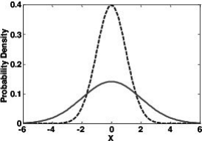
Variance (cont.)
Expected Value is the average of a random variable and is often used as a “best guess” for the result
Variance and standard deviation are used to measure how close this guess would generally be

Slide 44
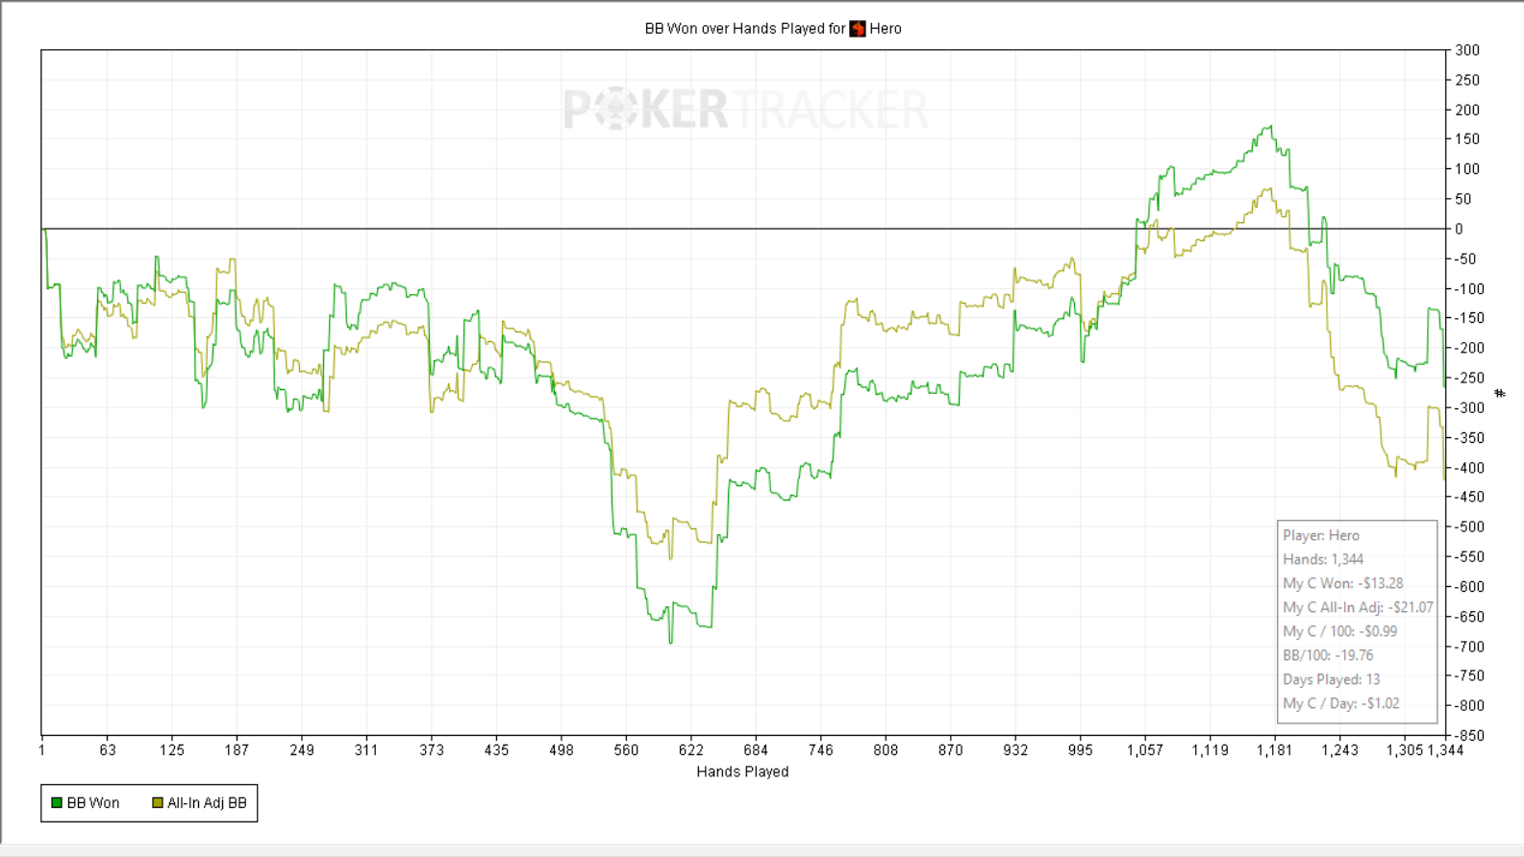
Variance (cont.)
All-in Equity considers the equity of your hand versus the actual hand your opponent held, relative to an all-in in that specific spot.
This provides us a precise measurement on how luck influences the outcome of the hands.

Slide 45
2.9 Law of Large Numbers
X is a random variable with mean μ with some distribution
Independent samples X1 , X2 , … Xn are drawn from the distribution.
“Sample mean” X̄ is the average of these samples.
It can be shown that E[X̄] = μ and Var[X̄] = Var[X]/n
The law of large numbers states that this sample mean X̄ is guaranteed to approach the actual mean μ as n (the number of samples) approaches infinity Law of Large Numbers

Slide 46
Law of Large Numbers (cont.)
This gives us another intuitive way to think of the mean - the average of infinite hypothetical trials
The law of large numbers also conveys a powerful idea: with enough data points, you can accurately estimate properties of random processes, even if their underlying distributions are unknown
With the ability of computation, certain quantities are now much easier to compute

Slide 47
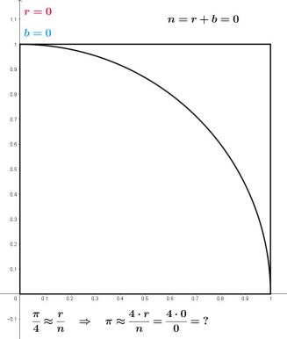
2.10 Monte Carlo Simulation
Style of computational methods to calculate a result using repeated random sampling and averaging (aka a direct application of LLN)
Ex: estimating π using geometric probability Monte Carlo Estimation using the relationship of a square and a circle

Slide 48
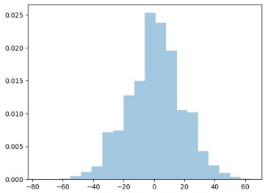
Monte Carlo Simulation (cont.)
Another example is the way we run Pokerbots matches!
Dividing the cumulative deltas by 1000 is a Monte Carlo estimate for the expected number of chips gained in a single round
Therefore a good PokerBot should try to maximize the expected number of chips earned within a single hand

Slide 49
MonteCarlo_Bot
Calc_strength() function runs Monte Carlo Simulation to estimate the probability of the bot’s current two-card hand winning against a random opponent’s hand.
For each iteration, it simulates the round, removing the known hole cards from the deck, shuffling the remaining cards, dealing 2 cards to a hypothetical opponent, dealing the remaining community cards, then compares the strength of the bots hand (hole cards + community cards) vs the opponent's hand (opponents hole cards + community cards)

Slide 50
MonteCarlo_Bot
A score is updated based on whether the bot’s hand wins, ties, or loses. Finally it returns a “hand strength” value, which is the normalized score representing the likelihood of winning or tying.
We use the eval7 python library: eval7.evaluate(our_hand), eval7.evaluate(opp_hand) which returns the strength/rank of that poker hand. A higher value represents a stronger hand (flushes and straights will be much higher value than single pairs). The specific numerical scheme for eval7 allows for direct comparison: If value_A > value_B, whichever hand has the higher eval7.evaluate value will be the stronger hand.

Slide 51
MonteCarlo_Bot
The get_action() function takes in the game_state, round_state, and active player index as inputs. Considering the legal_actions, the current street, my_cards, board_cards, chip contributions (my_pip, opp_pip), remaining stacks (my_stack, opp_stack), and continue_cost to stay in the pot, and the min/max raise limits.
In the get_action() function calc_strength is called to get the Monte-Carlo Simulated Hand Strength, if there is a continue cost (the opponent has bet) the bot adjusts the Monte-Carlo hand strength based on the size (scary) of the opponent bet.
Then the bot calculates pot odds and calls/fold accordingly with a 50/50 chance of raising if the adjusted hand strength is > 0.5.

